Slide 1
Introduction to Quantum Computing:
From a Layperson to a Programmer in 30 Steps
Hiu-Yung Wong
https://link.springer.com/book/10.1007/978-3-030-98339-0
https://www.amazon.com/Introduction-Quantum-Computing-Layperson-Programmer/dp/3030983382
Playlist: https://www.youtube.com/watch?v=wDXQcGiNU-A&list=PLnK6MrIqGXsJfcBdppW3CKJ858zR8P4eP&index=51
https://www.youtube.com/watch?v=7Qvh-4giszI&list=PLnK6MrIqGXsJfcBdppW3CKJ858zR8P4eP&index=52

Slide 2
Shor’s Algorithm

Slide 3

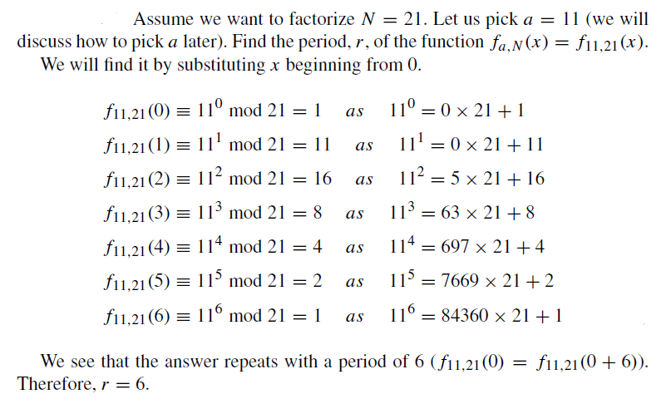

Background: Factoring and Period Finding
a)
we usually generate a very big integer number, N, using two large prime numbers, P and Q, such that N = P × Q.
N is shared with the public, and only the persons who have a key can find P andQ quickly.
b)
prime integer factorization
prime integer factorization of N is related to the period finding of a certain function.

Slide 4
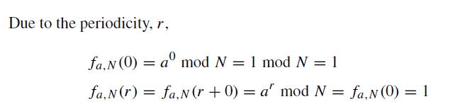

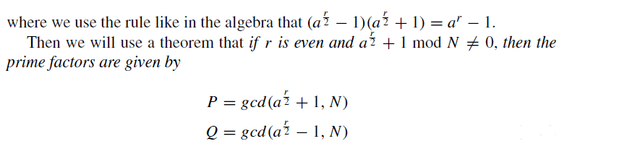
Background: Factoring and Period Finding

Slide 5
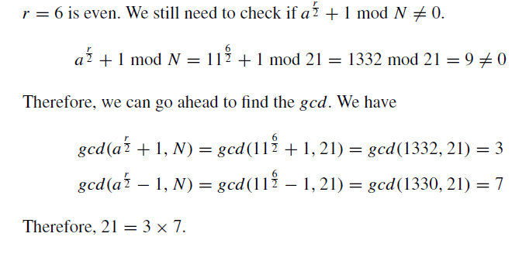

Slide 6
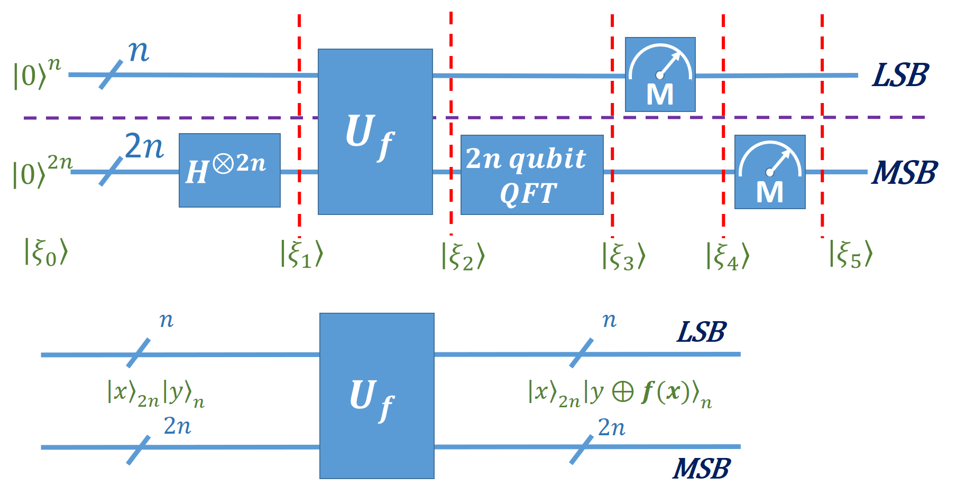
Shor’s Algorithm
1. Create a superposition of exponentially many arguments.
2. Evaluate the function on a superposition of exponentially many arguments.
3. Compute a parallel Fourier transform on the superposition using QFT.
4. Sample the Fourier power spectrum to obtain the function’s period.

Slide 7
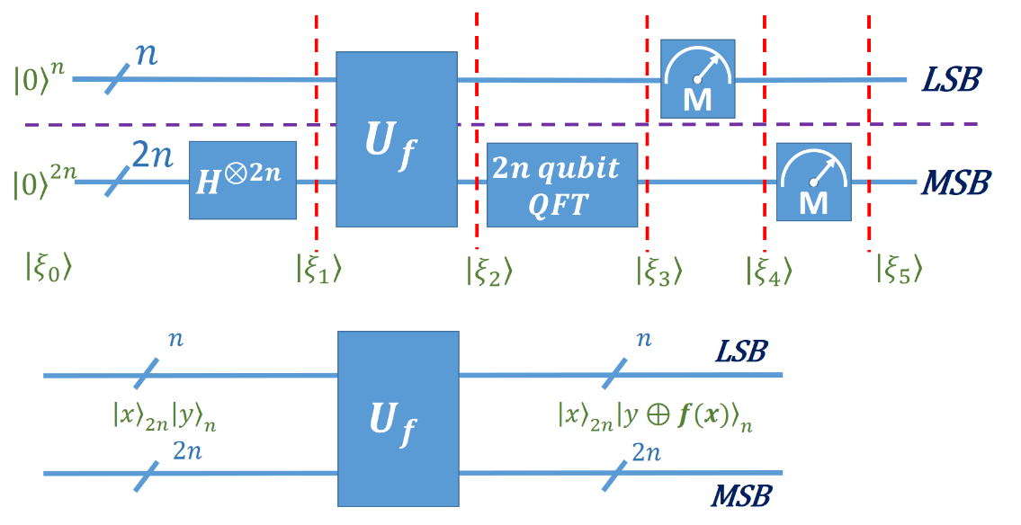

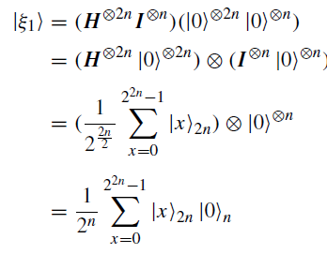

Slide 8
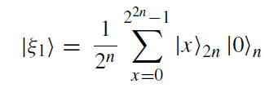

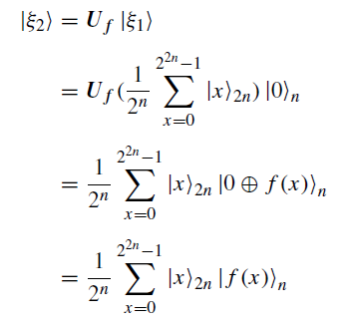
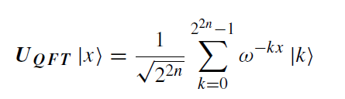

Slide 9
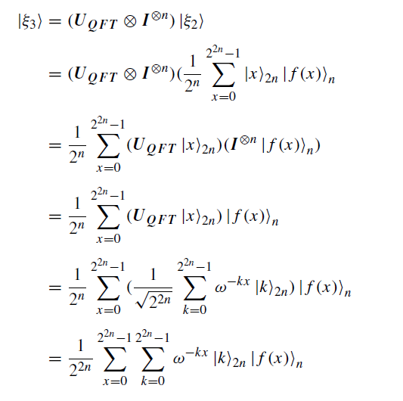

Slide 10
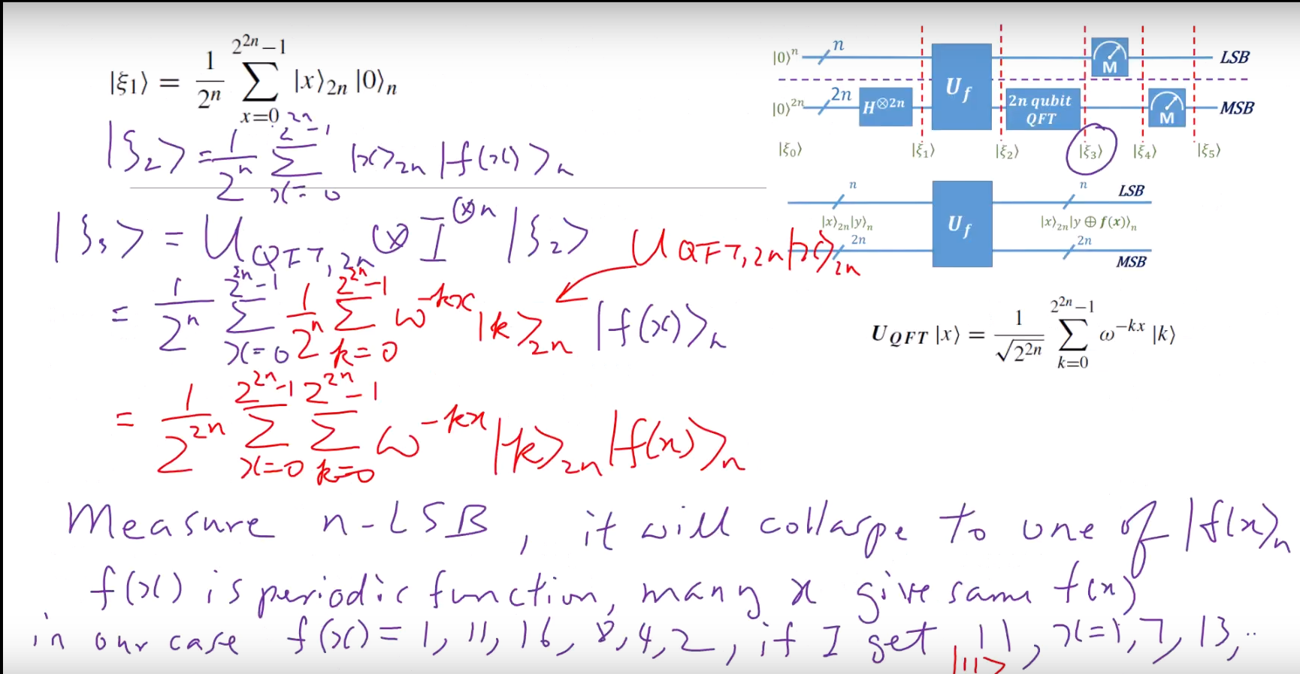

Slide 11
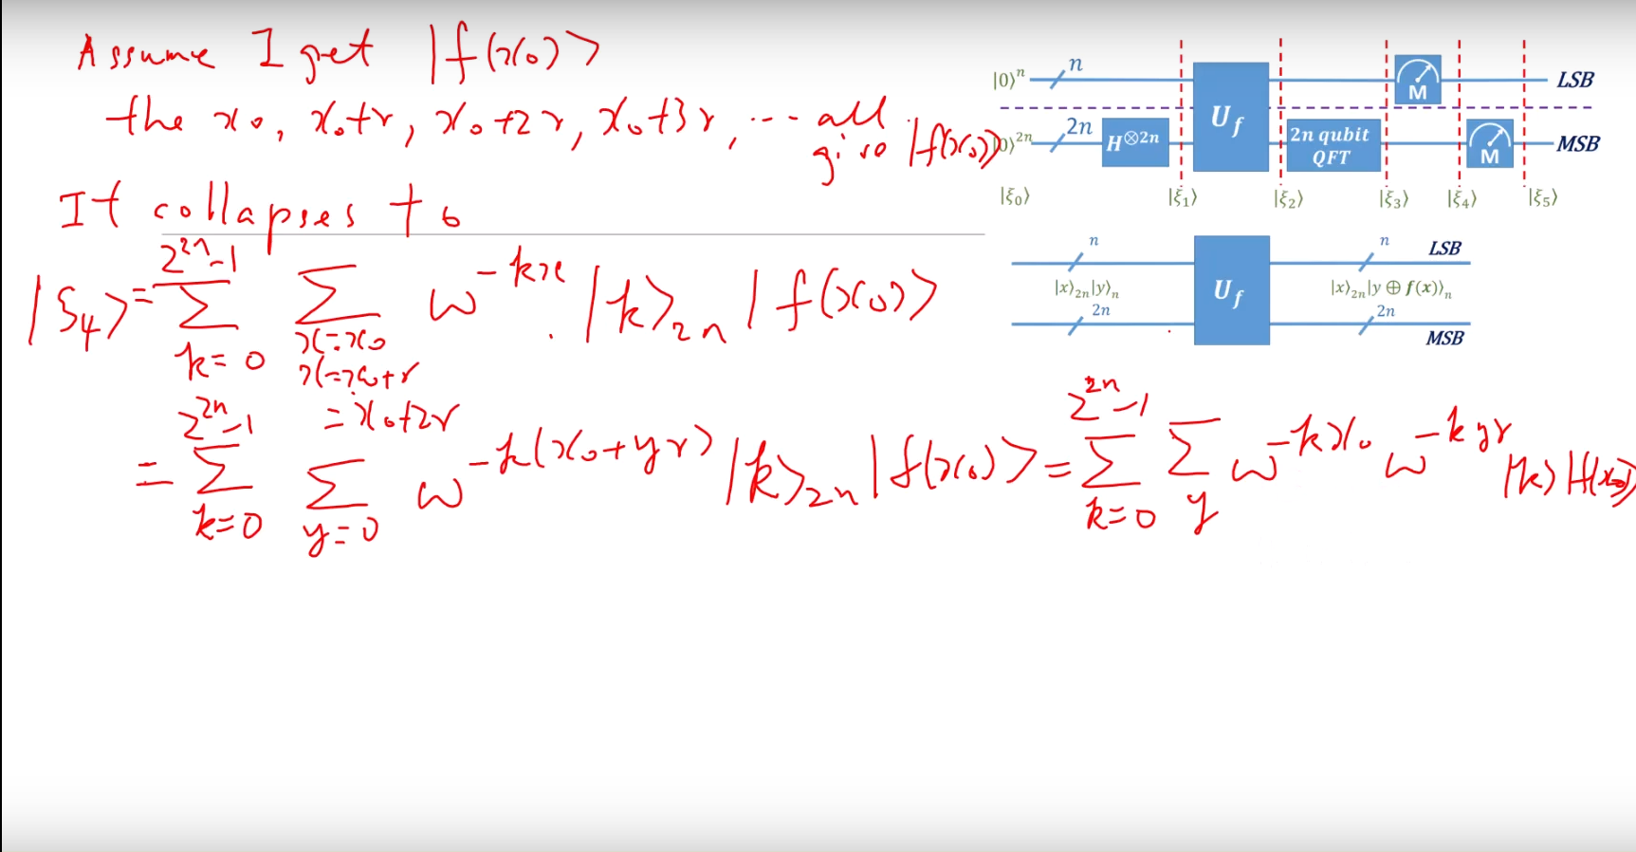

Slide 12
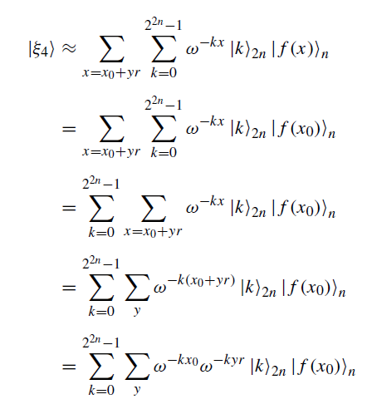

Slide 13
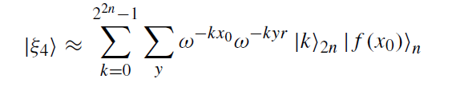
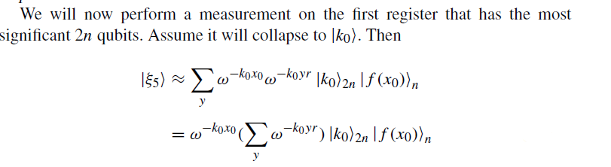
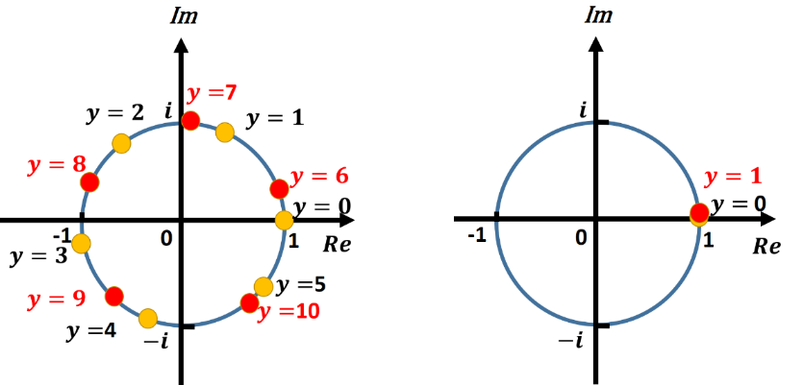
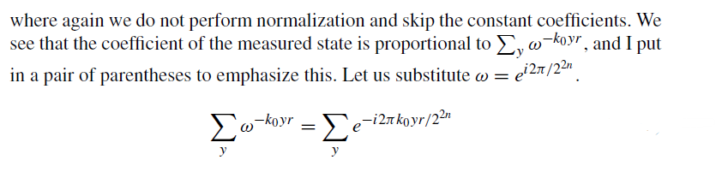

Slide 14
